Slide 1

Austin Transportation Department Signs Work Orders
Created By: Susanne Gov Created Date: 2020-05-21 Location Name: FM 2222 RD / MC NEIL DR Intersection ID: 5147094 Cardinal Direction: N
Sign Type | Install/Remove

Slide 2
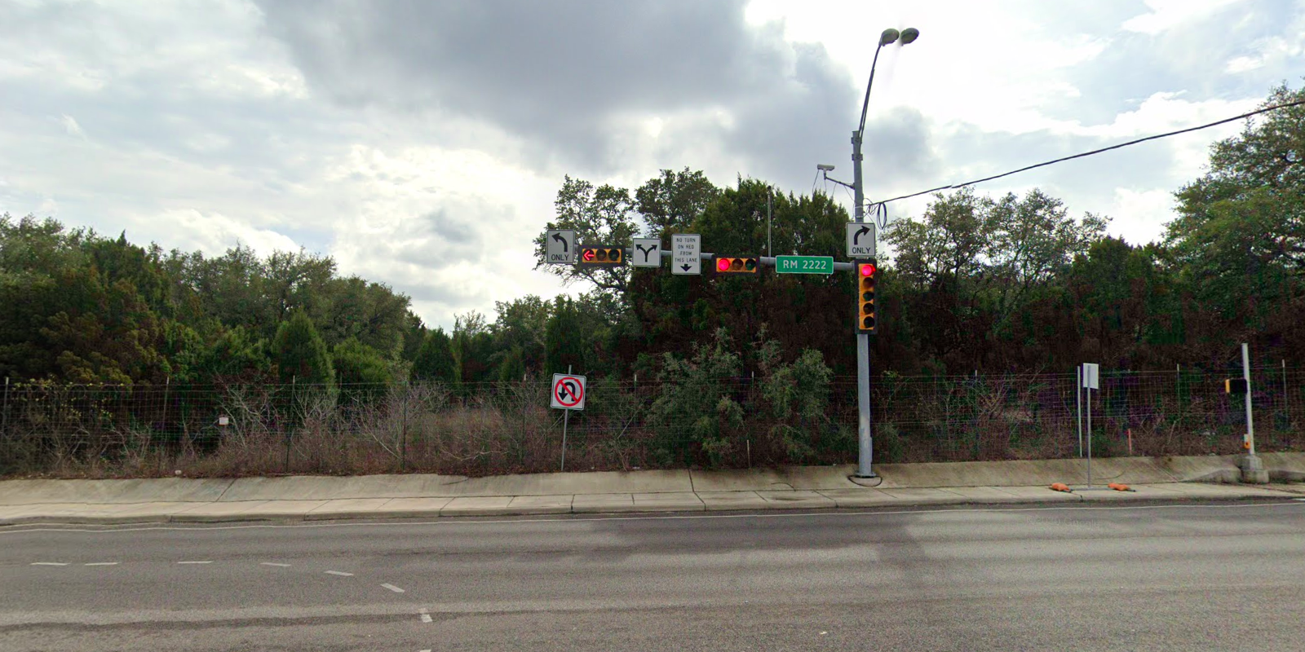
Austin Transportation Department Signs Work Orders
Created By: Susanne Gov Created Date: 2020-05-21 Location Name: FM 2222 RD / MC NEIL DR Intersection ID: 5147094 Cardinal Direction: S
Sign Type | Install/Remove
Street Name Sign | Install
Left Turn Arrow Only | Install
Right Turn Arrow Only | Install
Left Right Turn Arrow | Install
No Turn On Red On This Lane | Install

Slide 3
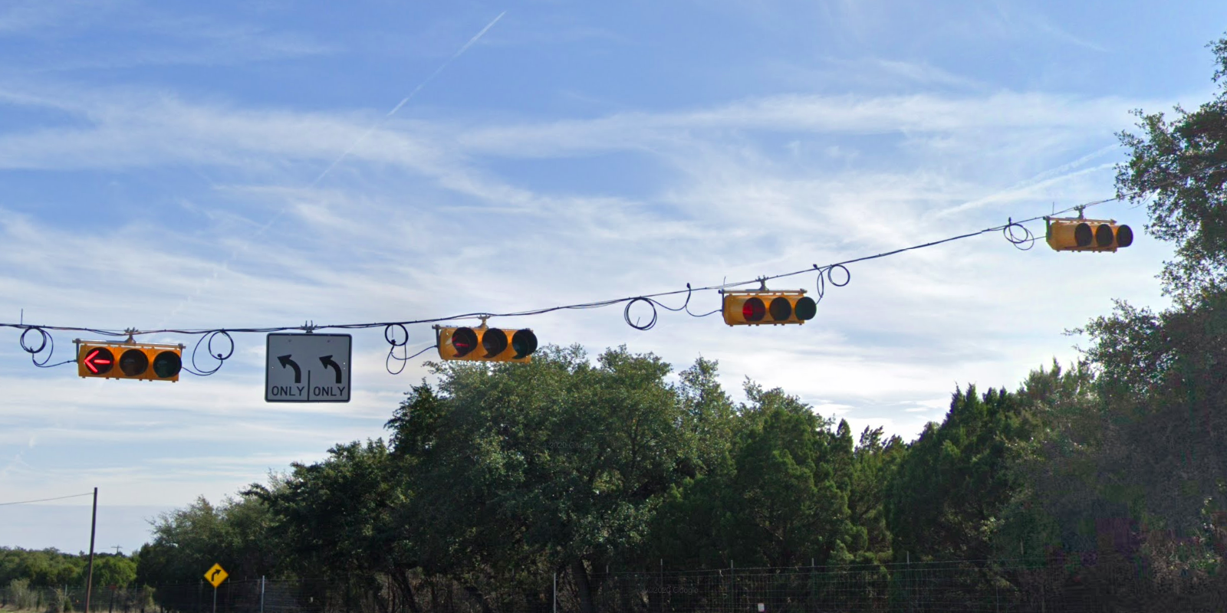
Austin Transportation Department Signs Work Orders
Created By: Susanne Gov Created Date: 2020-05-21 Location Name: FM 2222 RD / MC NEIL DR Intersection ID: 5147094 Cardinal Direction: E
Sign Type | Install/Remove
Left Turn Arrow Only | Install
Left Turn Arrow Only | Install

Slide 4
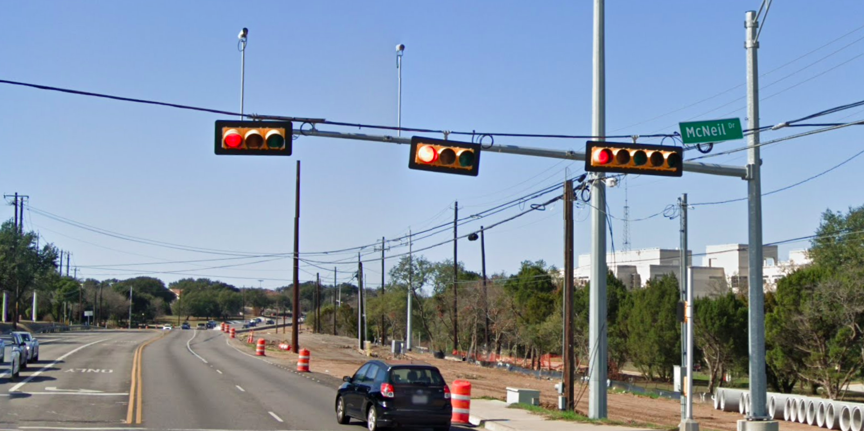
Austin Transportation Department Signs Work Orders
Created By: Susanne Gov Created Date: 2020-05-21 Location Name: FM 2222 RD / MC NEIL DR Intersection ID: 5147094 Cardinal Direction: W
Sign Type | Install/Remove
Street Name Sign | Install

